Slide 1
When you write a program in Java, what do you declare (at the highest level)?
Classes
What do you declare for classes?
Attributes (variables)
Methods
How is a method invocation done?
Method invocation involves two methods
Caller method & callee method
What are objects?
Instances of classes
Person
name:
School
attends
Student
Id:
yearOfStudy:
getAddr()
getStdAddr(){ }
getAddr(){}

Slide 2
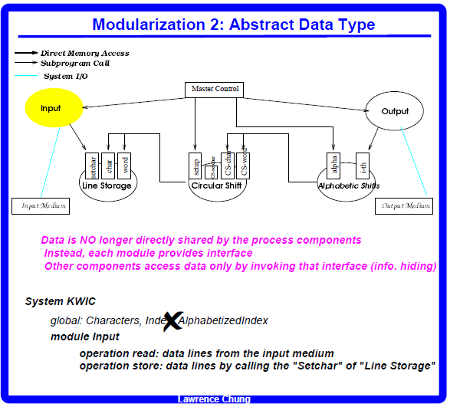

Slide 3
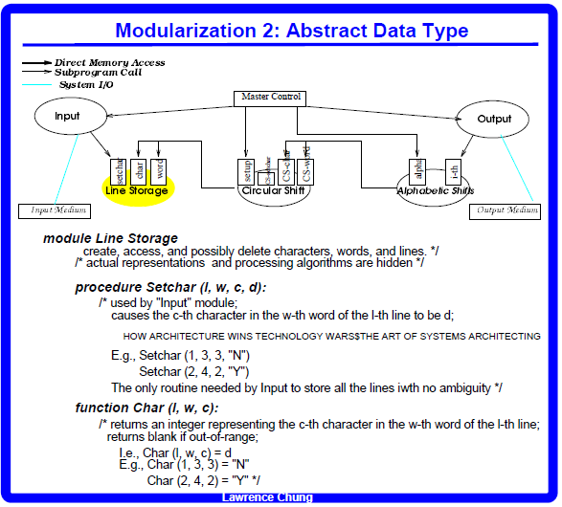
side-effect
Setchar (1, 1, 1, “H”)
Setchar (1, 1, 2, “O”)
Char (1, 1, 1) = “H”

Slide 4
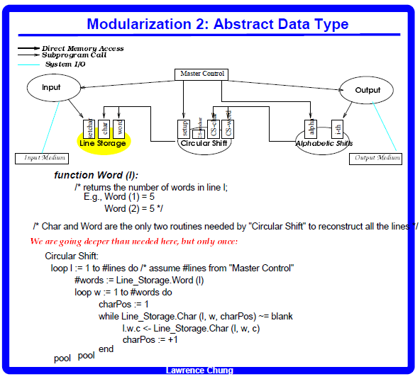

Slide 5
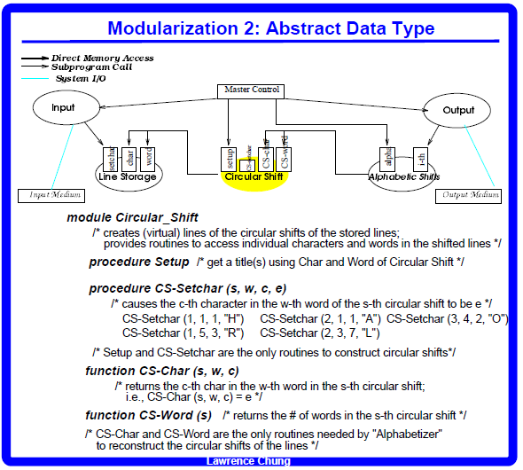

Slide 6
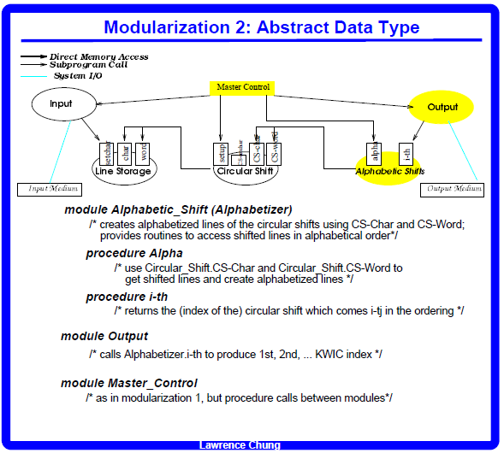

Slide 7
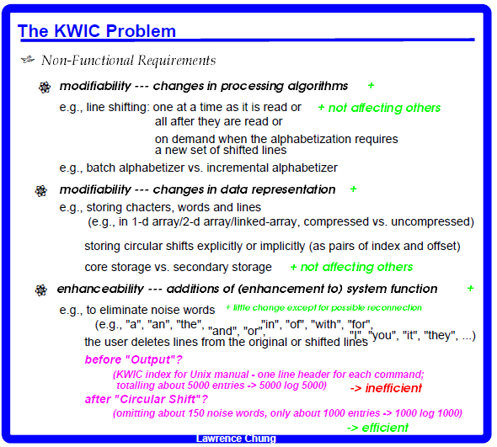

Slide 8
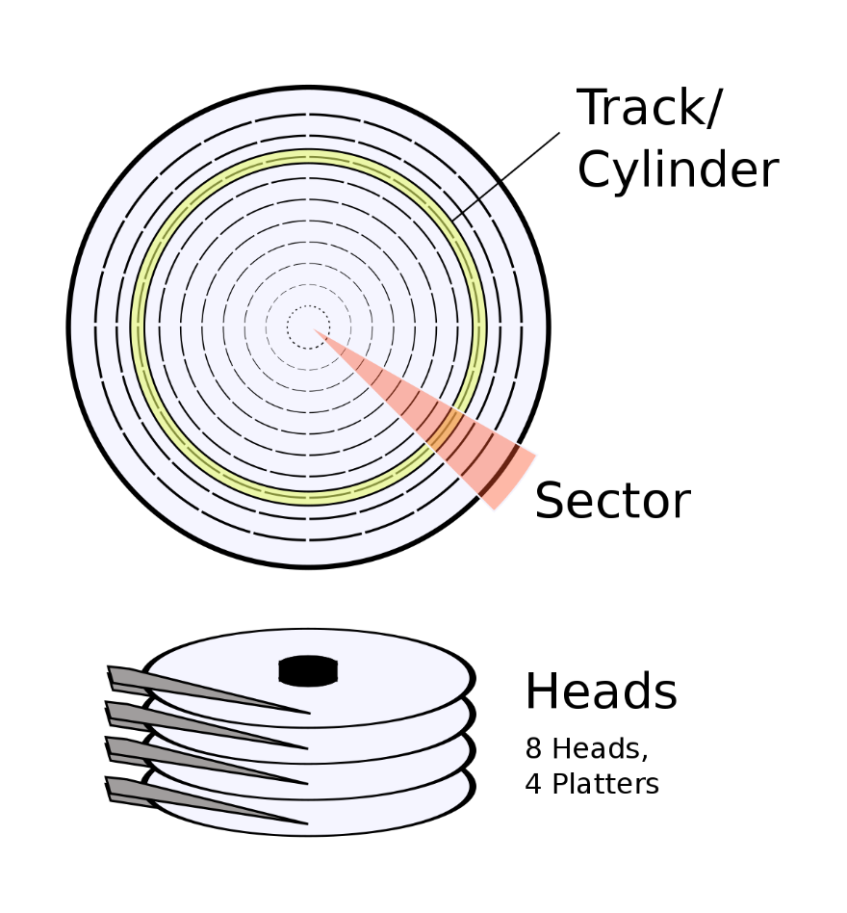
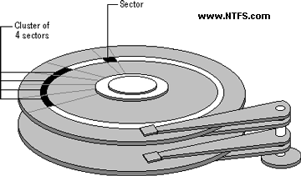
Incremental Circular Shift Incremental Alphabetizer
Why?
Random Access Memory (RAM) takes nanoseconds to read from or write to, while hard drive (IDE, SCSI, SATA that I'm aware of) access speed is measured in milliseconds.
Windows NTFS
(NT file system; sometimes New Technology File System)

Slide 9
Incremental Circular Shift Incremental Alphabetizer
Batch processing
Input
Circular shifts
Alphabetized
Beauty and the beast
and the beast Beauty
the beast Beauty and
beast Beauty and the
Circle of life
of life Circle
life Circle of
and the beast Beauty
beast Beauty and the
Beauty and the beast
Circle of life
life Circle of
of life Circle
the beast Beauty and
Beauty and the beast
Beauty and the beast
and the beast Beauty
the beast Beauty and
beast Beauty and the
and the beast Beauty
beast Beauty and the
Beauty and the beast
the beast Beauty and
Circle of life
Circle of life
of life Circle
life Circle of
Circle of life
life Circle of
of life Circle

Slide 10
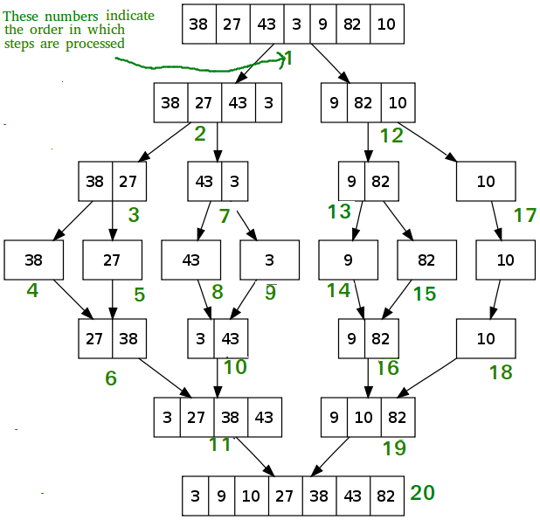
Incremental Circular Shift Incremental Alphabetizer
How?
Beauty and the beast
and the beast Beauty
the beast Beauty and
beast Beauty and the
Circle of life
of life Circle
life Circle of
and the beast Beauty
beast Beauty and the
Beauty and the beast
the beast Beauty and
Circle of life
life Circle of
of life Circle
and the beast Beauty
beast Beauty and the
Beauty and the beast
Circle of life
life Circle of
of life Circle
the beast Beauty and
https://www.geeksforgeeks.org/merge-sort/

Slide 11
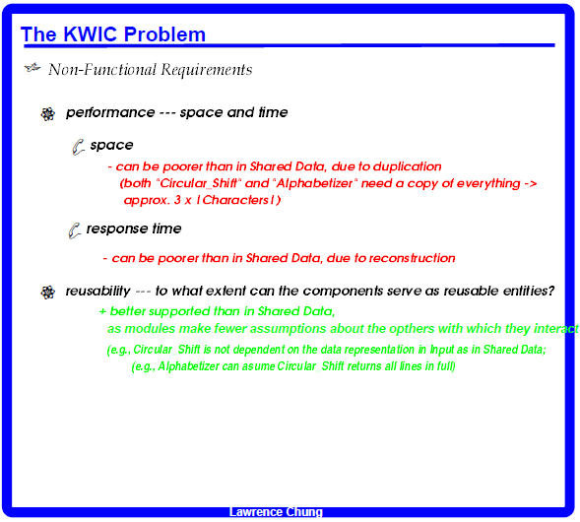

Slide 12
